Slide 1

Use Genetic Algorithm via MATLAB: Engineering Case Studies
Professor Bo Liu
James Watt School of Engineering

Slide 2
Antenna design problem
Problem description
Dipole antenna
The geometry parameters [l, r] determine the performance of the antenna.

Slide 3
Antenna design problem
Problem description:
Dipole antenna: center frequency at 2 GHz.
Design requirements:
the magnitude of the S₁₁ is less than -10 dB within the frequency range [1.8 GHz 2.2 GHz].
l is between 60 mm and 90 mm.
r is between 0.1 mm and 0.5 mm.

Slide 4
Antenna design problem
Optimization problem formulation
minimize
f_{i}∈[1.8GHz 2.2GHz]
x=[l, r]
l∈[60mm 90mm]
r∈[0.1mm 0.5mm]
f_{i} is the ith frequency sample in the frequency band.
K is the number of samples in frequency band.
|·|* is defined as summing the number of frequency points whose values of is above -10dB.

Slide 5
Formulate the objective function in MATLAB
function y=func_antenna(x)
fre=2*1e9;% Set center operating frequency (Hz)
subobject=design(dipole,fre);% Create antenna type: dipole
subobject.Load.Impedance=100;% Set excitation port impedance
% S Set antenna size
subobject.Length=x(1);
subobject.Width=x(2);
S_data=sparameters(subobject,1*1e9:2e7:3*1e9,201); % S parameter calculation
y=sum((mag2db(abs(S_data.Parameters(1,1,41:61)))>-10));
figure(1);h=rfplot(S_data);
end
Design parameters
Objective function
https://uk.mathworks.com/videos/designing-antennas-and-antenna-arrays-with-matlab-and-antenna-to-1483477877085.html
See live script

Slide 6
Perform GA for finding the optimal design
clear all;
clc;
rng default
options = optimoptions('ga','PlotFcn', @gaplotbestf,'PopulationSize',10,'MaxGenerations',25);
[x]= ga(@func_antenna,2,[],[],[],[],[60/1000 0.1/1000],[90/1000 0.5/1000], [],options)
Output
Design parameter bounds

Slide 7
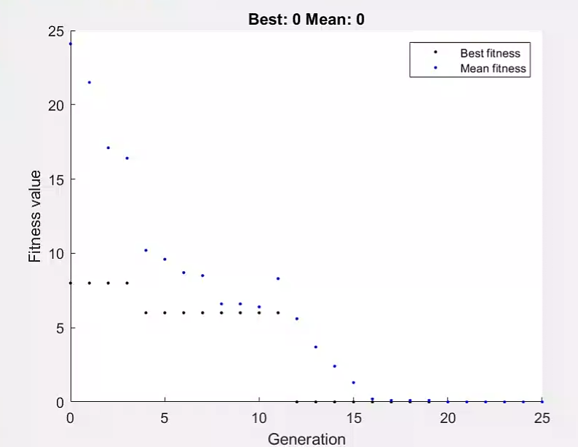
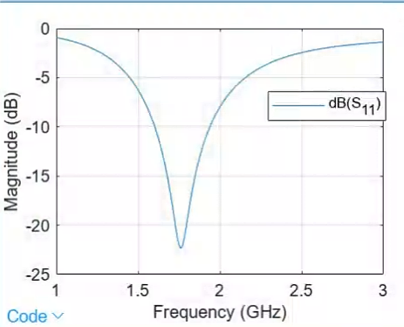
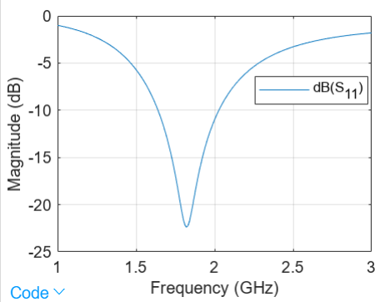
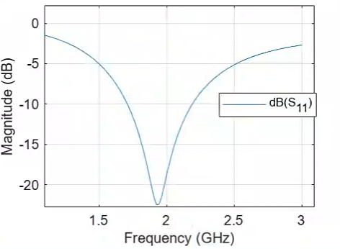
Perform GA for finding the optimal design
Optimization process
This solution meets design requirements.
See live script

Slide 8
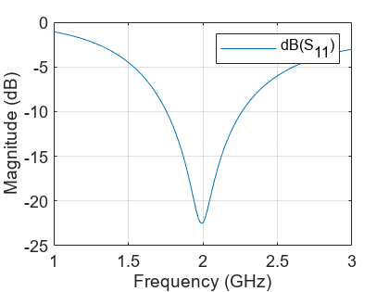

Perform GA for finding the optimal design
Optimization results
See live script

Slide 9
Perform GA for finding the optimal design and the objective function value
clear all;
clc;
rng default
options = optimoptions('ga','PlotFcn', @gaplotbestf,'PopulationSize',10,'MaxGenerations',25);
[x fval]= ga(@func_antenna,2,[],[],[],[],[60/1000 0.1/1000],[90/1000 0.5/1000], [],options)
Output

Slide 10
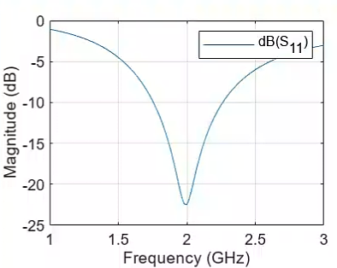

Perform GA for finding the optimal design and the objective function value
Optimization results
See live script

Slide 11




Thanks!
#UofGWorldChangers
@UofGlasgow

